Slide 1
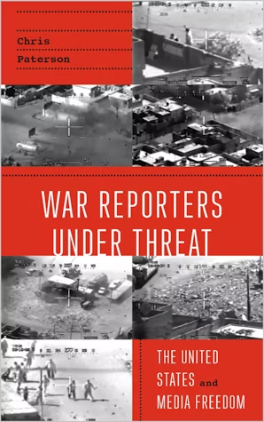
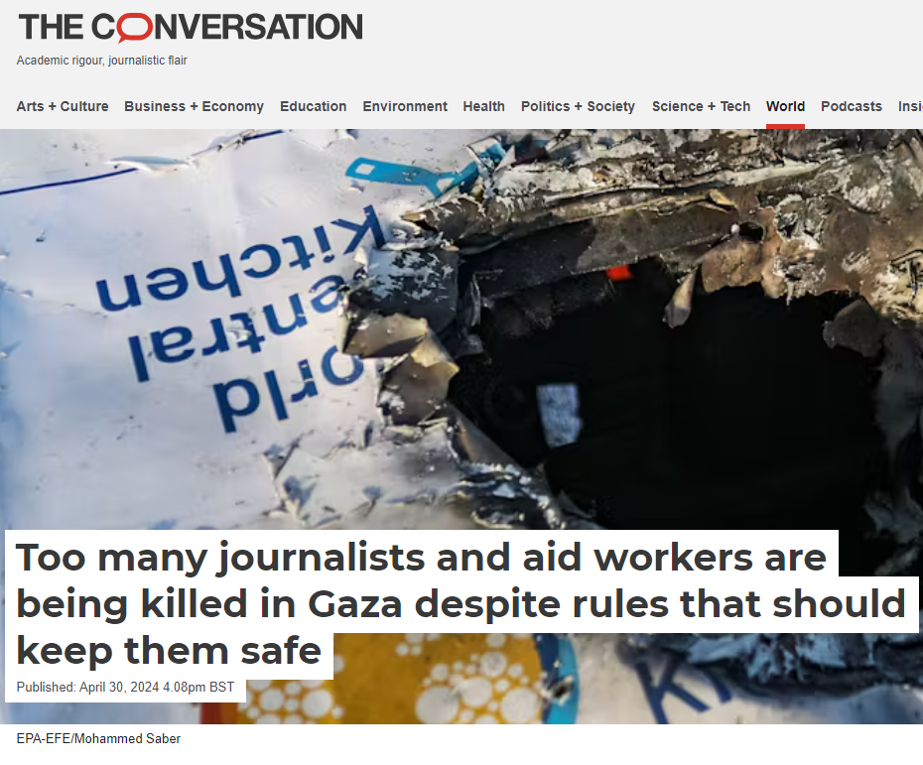
Chris Paterson
School of Media and Communication
University of Leeds

Slide 2
to maintain asymmetrical advantage in global media coverage:
ensure media organizations face high degrees of scrutiny of their reporting
censorship and restrictions can be imposed on journalists
access to sources can be granted and rescinded
broadcasting facilities and journalists may be targeted by the belligerents
selectively collaborate with media organizations
From: Tasseron, M. and Lawson, B.T., 2022. Legitimizing military action through statistics and discourse in the 2014 IDF assault on Gaza. Media, War & Conflict, 15(2)

Slide 3
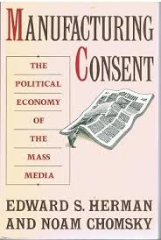
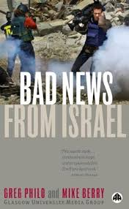

Slide 4
Discursive asymmetry ( (Tasseron and Lawson, 2022)
“Most attacks have so far been from the air, hitting some 1200 targets in the territory” (Rabinovitch, 2014)
“More than 200 rockets have been launched at Israel from the Gaza Strip, the military said” (Reuters, 2014b)

Slide 5
https://www.chathamhouse.org/publications/the-world-today/2003-12/reporting-conflict-aiming-stop-story

Slide 6
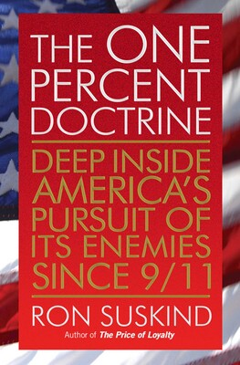
“My sources are clear that that was done on purpose,
precisely to send a message to Al Jazeera,
and essentially a message was sent…
There was great anger at Al Jazeera.”

Slide 7
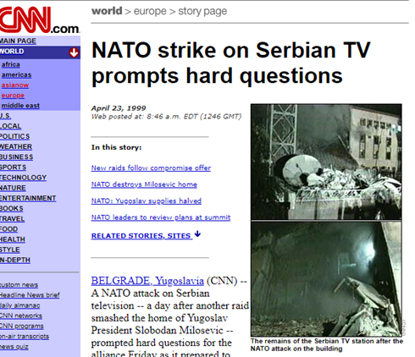
concern about safety in the first Gulf war
initiatives to work with the military
Army ‘interns’ at NPR and CNN satellite desk
missiles hitting media operations
Paterson, “War Reporters”

Slide 8
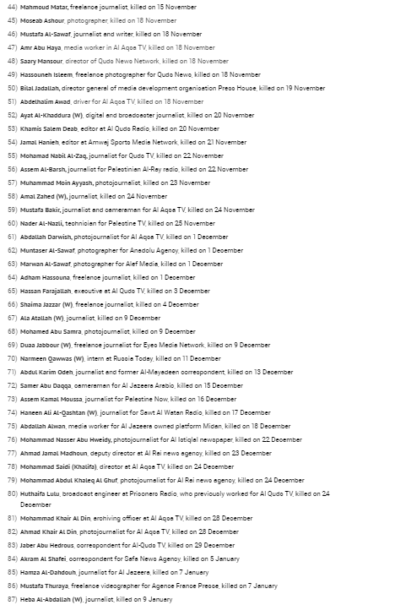
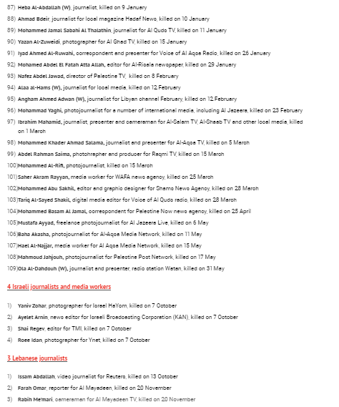
IFJ, 10 June, 2024
https://www.ifj.org/war-in-gaza

Slide 9
